Slide 1
Principles of Congestion Control
Congestion:
informally: “too many sources sending too much data too fast for network to handle”
different from flow control!
manifestations:
  lost packets (buffer overflow at routers)
  long delays (queueing in router buffers)
a top-10 problem!

Slide 2
Reasons
Flood of traffic destined for the same output line (queue fills up and packets drop)
  Memory does not necessarily solve this problem
Slow processors, or inefficient routing software
Mismatch between parts of the system (several fast lines and one slow)
Congestion tends to feed on itself and make things worse

Slide 3
Congestion vs. Flow Control
Congestion control has to do with making sure the subnet is able to carry the traffic
Congestion is a global issue, involving all hosts and routers
Flow control relates to point-to-point traffic between a given sender and a given receiver (supercomputer dumping to a PC over fiber)

Slide 4
General Principles
Solutions to congestion problems can divided into two groups: open loop and closed loop.
Open loop solutions try to solve the problem by preventing it in the first place.
  deciding when to accept new traffic
  when to discard and what to discard
  making scheduling decision
These decisions are made without regard to the current state of the network

Slide 5
Closed Loop Solutions
Closed loop solutions are based on the concept of a feedback loop.
Feedback loops have three parts when applied to congestion control
  monitor the system to detect when congestion occurs
  pass this information to places where actions can be taken
  adjust system operation to correct the problem

Slide 6
Monitoring Metrics
Various methods can be used to monitor the subnet for congestion
  percentage of packets discarded for lack of buffer space
  average queue lengths
  number of packets that time out and are retransmitted
  average packet delay
  standard deviation of packet delay
In all cases rising numbers indicate growing congestion

Slide 7
Transferring Information
The most obvious way to do is to send a message to the point where something can be done about it
These packets may in turn make the congestion worse!!
Other possibilities exist
  reserve some space in normal packets
  periodic probes

Slide 8
Congestion Control Algorithms
Many congestion control algorithms are known.
A taxonomy has been developed to help organize them
The taxonomy starts by dividing all algorithms into open loop or closed loop solutions.
The open loop solutions are then divided into ones that act at the source versus ones that act at the destination.

Slide 9
Closed Loop Categories
Closed loop solutions are divided into two categories
  explicit feedback
  implicit feedback
In explicit feedback, packets are sent from the point of congestion to warn the source
In implicit feedback, the sources deduces the existence of congestion by making local observations

Slide 10
Solutions
The presence of congestion means that the load (hopefully temporarily) is greater than resources
Two solutions are possible
  increase the resources
  decrease the load

Slide 11
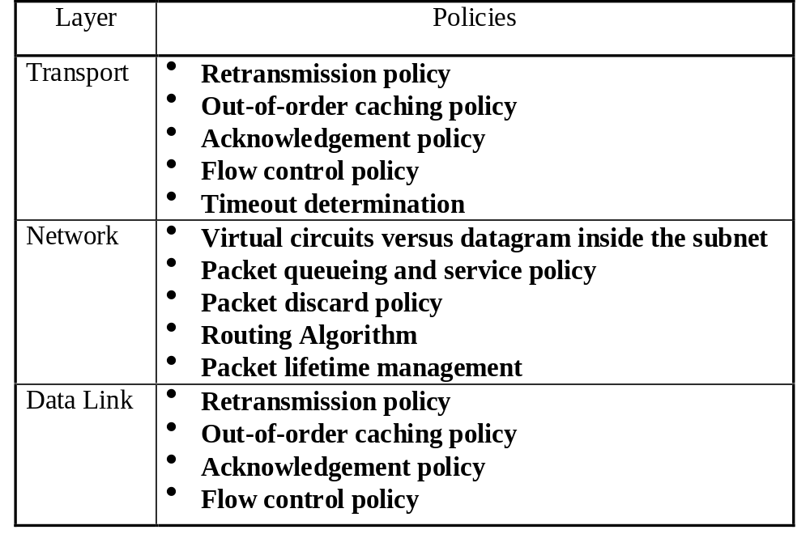
Policies that Affect Congestion

Slide 12
Traffic Shaping
One of the main causes of congestion is that traffic is bursty
Traffic shaping is an open loop method that tries to manage congestion by forcing the packets to be transmitted at a more predictable rate
Traffic shaping is about regulating the average rate (and burstiness) of data transmission
When the circuit is setup, the user and carrier agree on a shape for that circuit

Slide 13
Policing Mechanisms
Three criteria:
  (Long term) Average Rate (100 packets per sec or 6000 packets per min??), crucial aspect is the interval length
  Peak Rate: e.g., 6000 p p minute Avg and 1500 p p sec Peak
  (Max.) Burst Size: Max. number of packets sent consecutively, ie over a short period of time

Slide 14
Leaky Bucket Algorithm
Essentially what we want to do is to provide a consistent, even flow of traffic
Think of a bucket with a hole in the bottom, or a leaky faucet, no matter how much water enters the bucket the output flow is constant
That’s the idea behind the leaky bucket algorithm

Slide 15

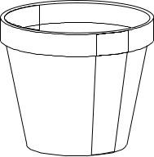
The Leaky Bucket
outflow is at a constant rate ρ, when there is water in the bucket, and zero when the bucket is empty

Slide 16
Implementation
A leaky bucket is nothing more that a single-server queueing system with constant service time
Packets arrive at any time, host is allowed to put only one packet per clock tick onto the network
If packets are different sizes, it is better to use a fixed number of bytes per tick, rather than one packet
When queue fills, new packets are dropped

Slide 17
Token Bucket Algorithm
The leaky bucket enforces a rigid output pattern
The token bucket algorithm allows the output to speed up somewhat when large bursts arrive
Here the bucket holds tokens, that are generated by a clock at a rate of one token every ΔT seconds
In order to transmit, you need a token
Idle hosts can save up permission to send bursts later

Slide 18
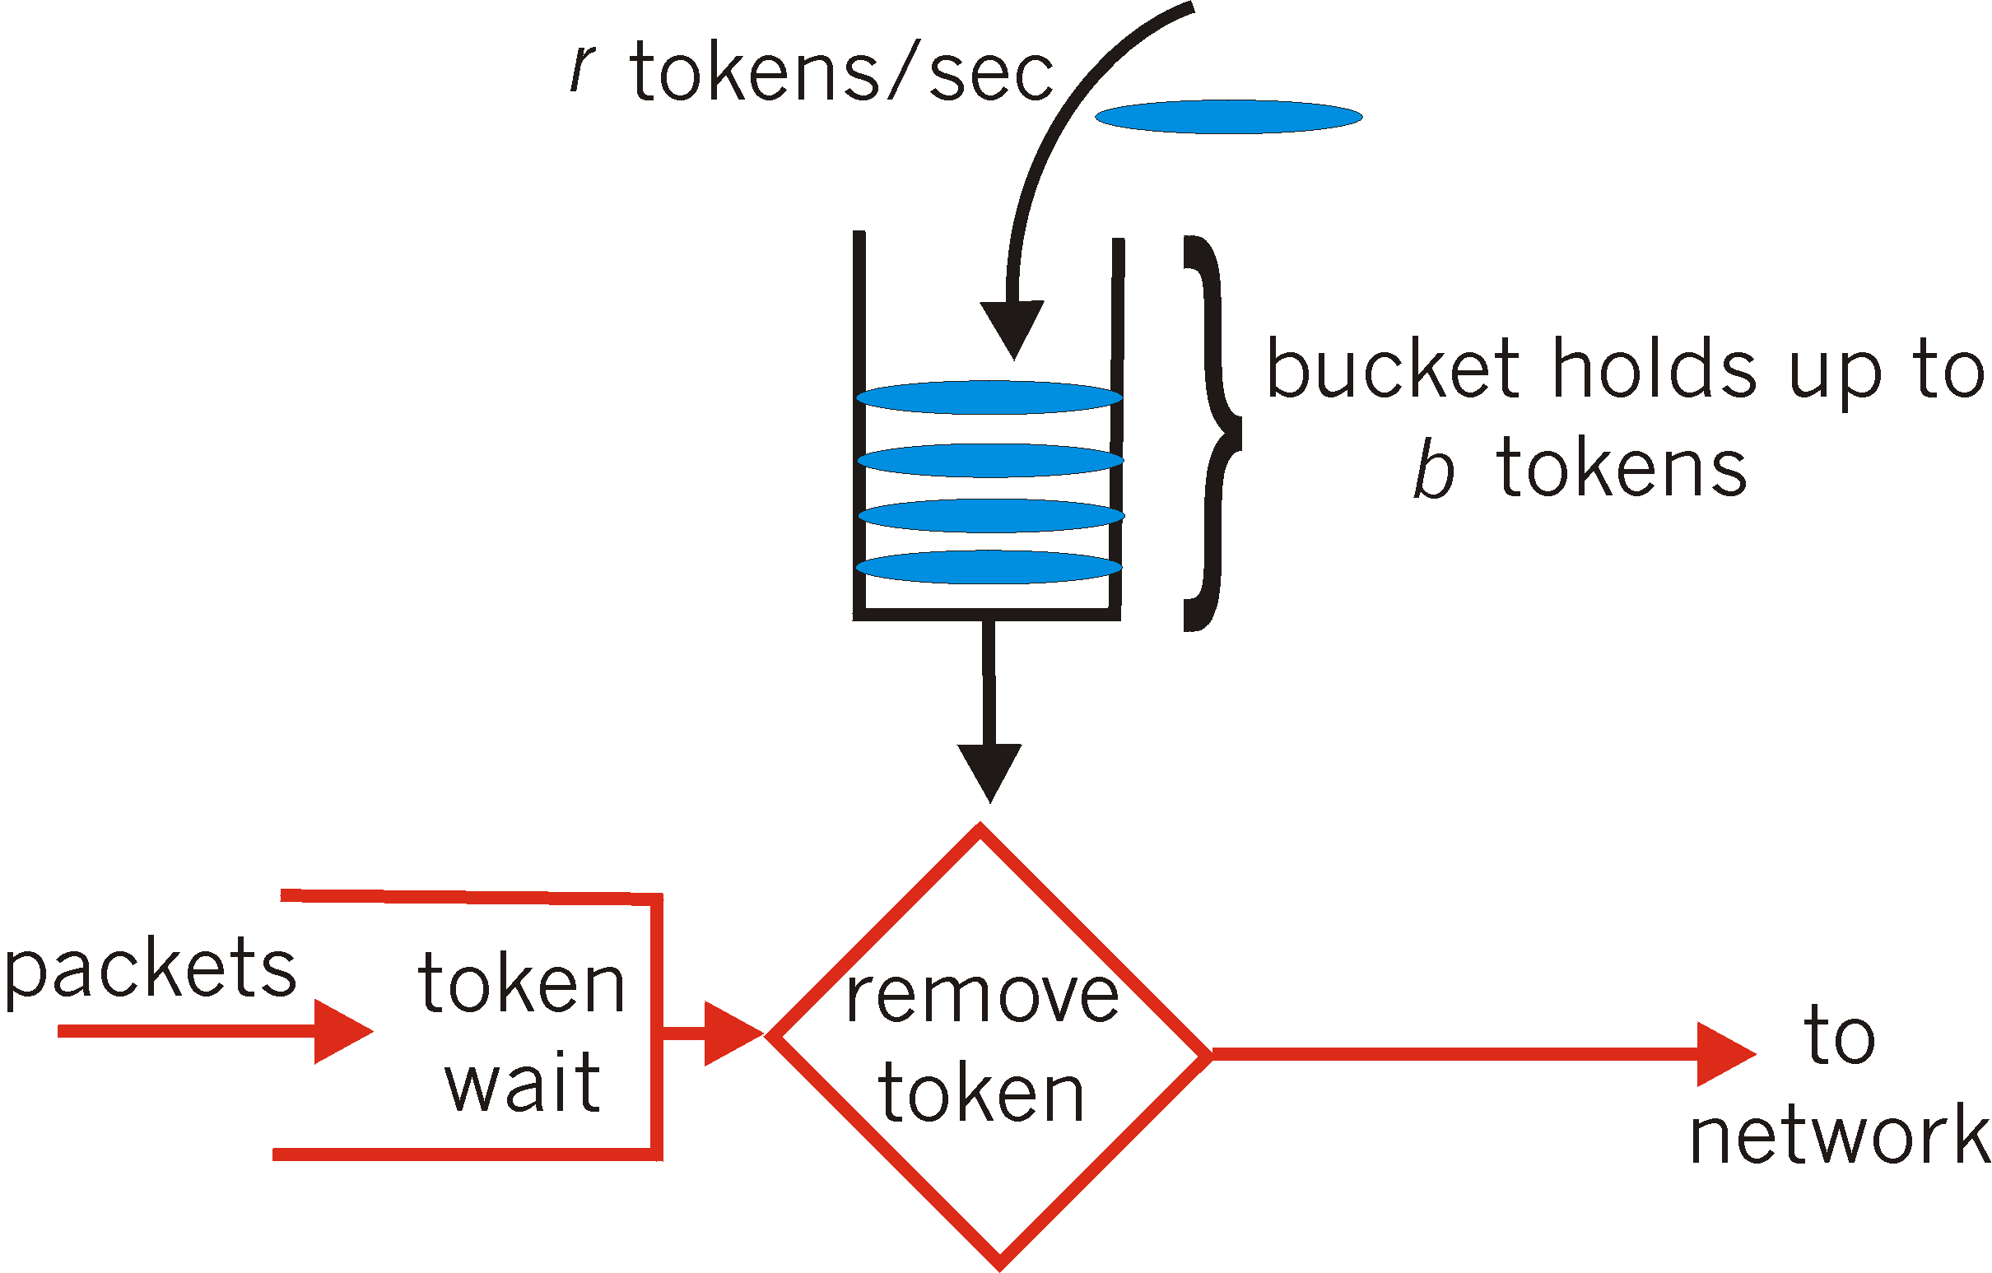
Policing Mechanisms
Token Bucket mechanism, provides a means for limiting input to specified Burst Size and Average Rate.

Slide 19
Other Strategies
Route around problem areas
  traffic reports in the morning
Implement a reservation system
  the host specifies the volume and shape of the traffic, the subnet reserves resources according to the request
Provide incentives for use at low-peak times

Slide 20
Congestion Control in Virtual Circuits
Admission Control: When congestion is detected and reported, do not allow any more virtual circuits to pass through congested routers.
Two versions:
  Can be done all the time (eliminates congestion)
  Can be done when needed (congestion can still occur)

Slide 21
Choke Packets
Can be applied to both virtual circuits and datagram subnets.
Each router monitors the subnet and measures utilization.
If at some line the utilization reaches a certain threshold, when a packet comes that will use that line for forwarding, the router sends a choke packet to the source host.
The sender will wait a certain amount of time that is specified in the choke packet before continuing to send any more packets to the same destination.

Slide 22
Hop-by-Hop Choke Packets
If source host is far away from the congestion region, it will take a long time for the choke packet to arrive and slow down the source.
Improvement: Make each router on the path receive and sent choke packets.
The choke packet is send to the router that forwarded the packet.
When the router receives the choke packet, it slows down, and sends a choke packet to sending router after it receives another packet having the same source and destination.

Slide 23
Load Shedding
When all other options are exhausted the obvious way is to discard packets.
It is better to be selective and discard lower priority packets.
However, must invent incentives to force hosts to actually use lower priorities.
Since congestions feed-on itself, it is better to begin discading packets early.

Slide 24
RSVP: Resource Reservation Protocol
A solution for multicasting congestion.
Allows multiple senders to transmit to multiple groups of receivers.
Permits individual receivers to switch channels freely.
Optimizes bandwidth and eliminates congestion.

Slide 25
RSVP: Resource Reservation Protocol
Is built as an additional feature to the spanning tree method used in multicast routing.
Knowing that it will receive packets from a certain host, the receiving host send a message towards the source telling any router on the path to reserve bandwidth for the channel.
In the backward routing of this message reverse path forwarding is used.

